Slide 1


Shield Insurance Feature Demonstration & User Guide
📊 Executive Overview | 🔍 Sales Mode Analysis | 👥 Age Group Analysis
Tool: Power BI

Slide 2
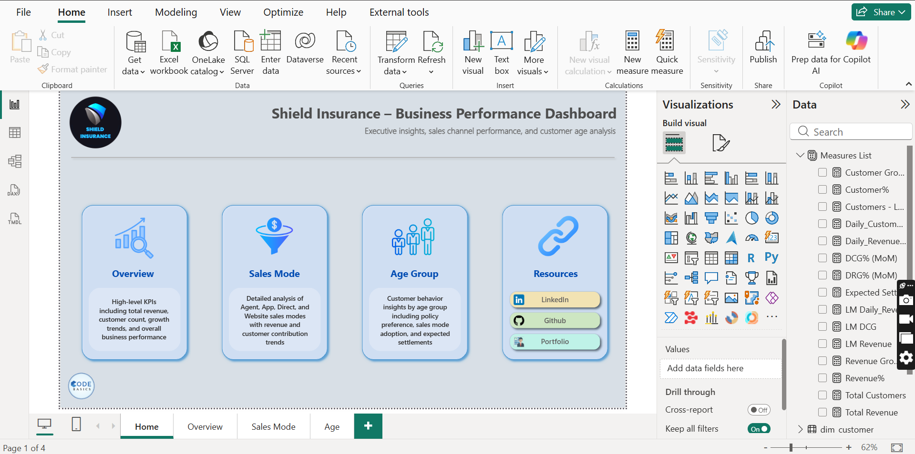
DASHBOARD OVERVIEW
This dashboard provides a consolidated view of:
Revenue performance
Customer growth
Sales channels
Age group behavior
It is designed for quick analysis and decision support
Data updates automatically based on selected filters

Slide 3
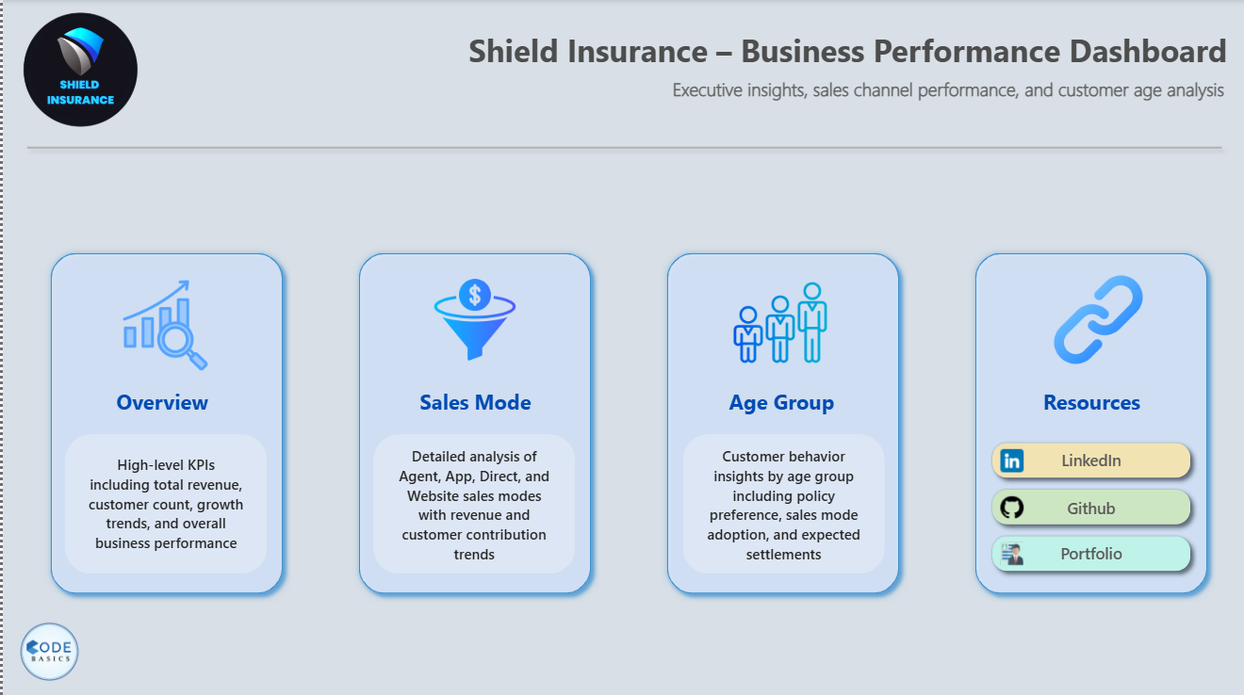
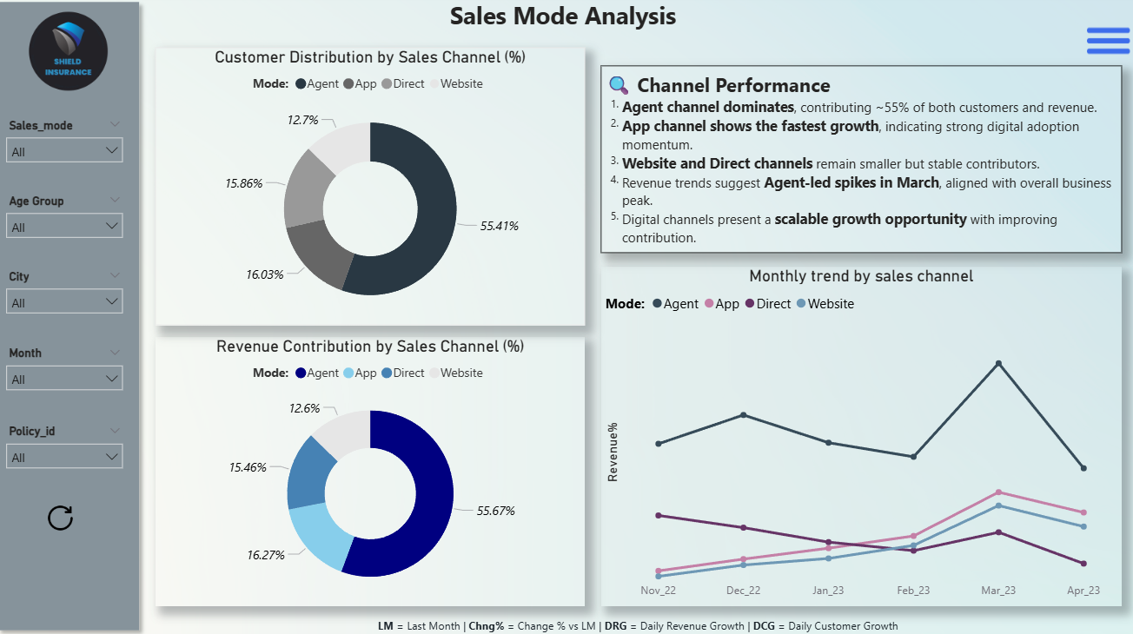
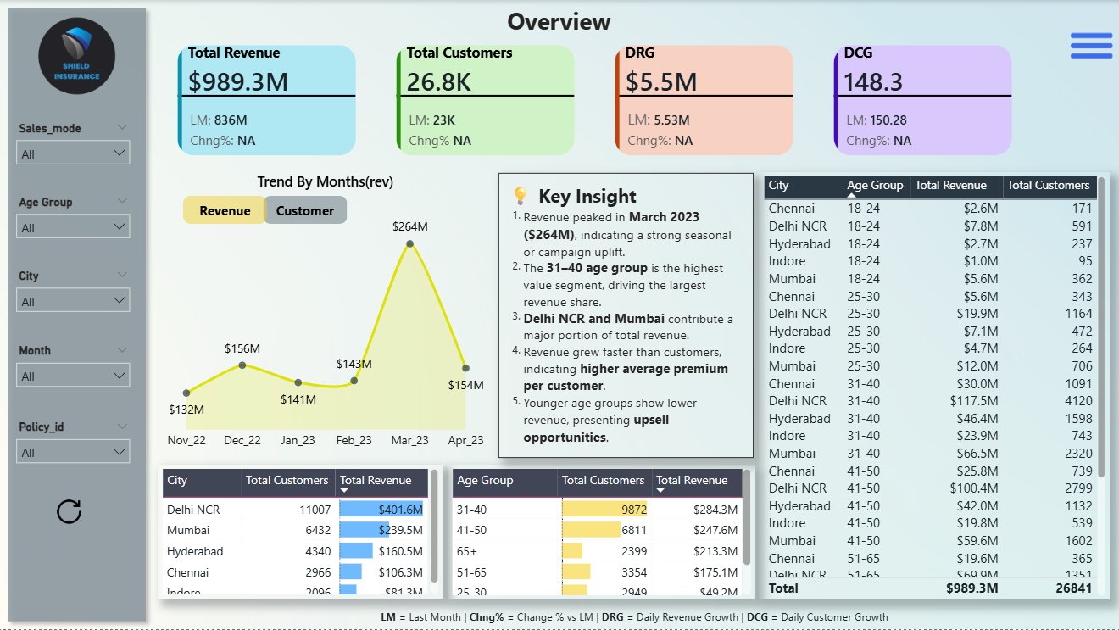
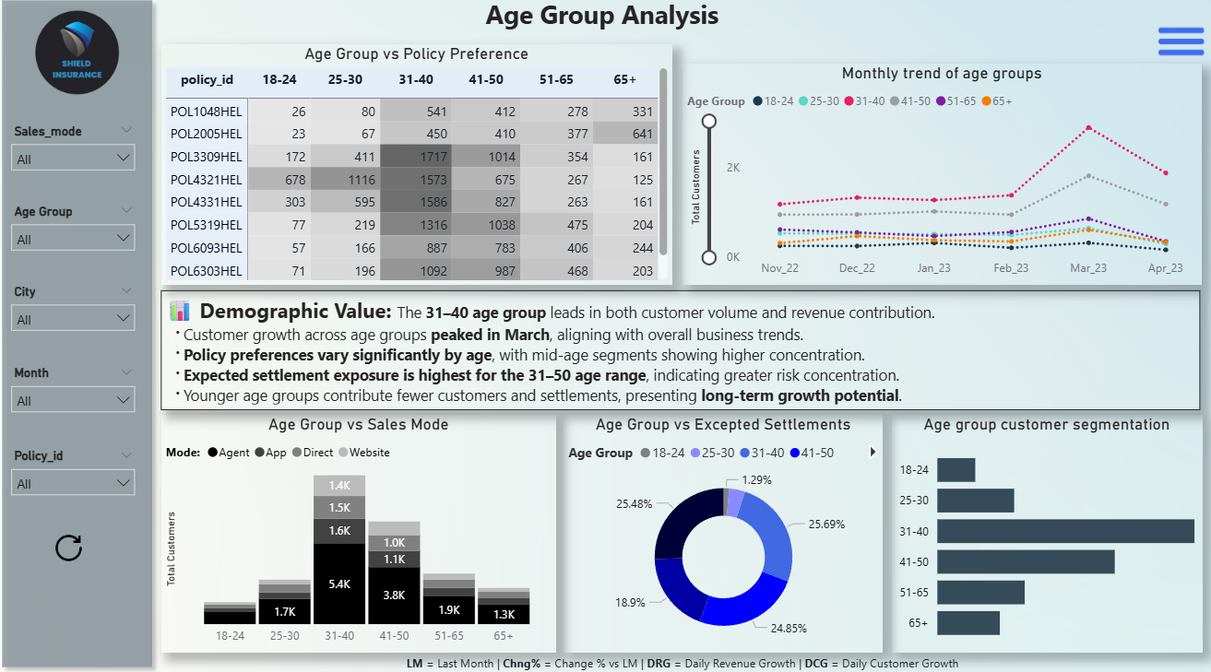
DASHBOARD PAGES
Home Page → Used for navigation across dashboard sections
Sales Mode Analysis → Shows performance by sales channel
Overview Page → Shows overall revenue, customers, and trends
Age Group Analysis → Shows customer and settlement behavior by age group

Slide 4
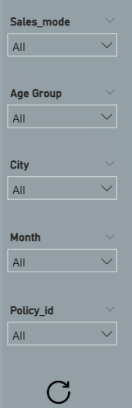
Feature 1: Dynamic Filtering
Dynamic Filtering Allows users to filter data by:
City
Month
Sales Mode
Age Group
Policy ID
All visuals update automatically
Supports single and multiple selections

Slide 5
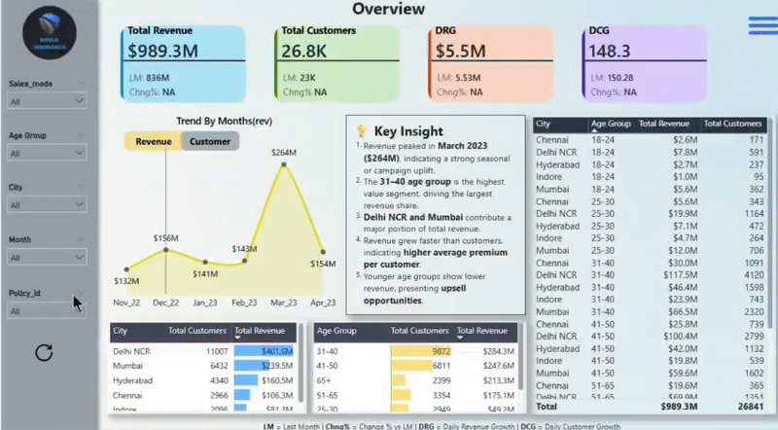
How Dynamic Filtering Works

Slide 6
Cross-Filtering Across Visuals
Selecting data in one visual filters other visuals
Enables deeper analysis without changing pages
Helps identify relationships between metrics

Slide 7
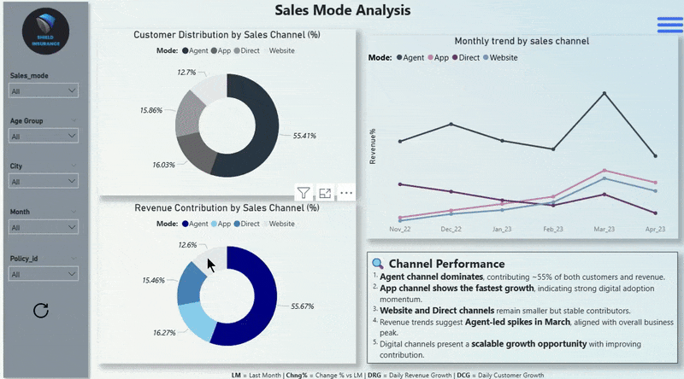
How Cross-Filtering Works

Slide 8

Metric Toggle
Users can switch between:
Revenue trend
Customer trend
Eliminates the need for multiple charts
Keeps the dashboard clean and focused

Slide 9
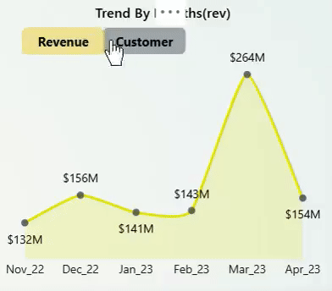
How the Toggle Works

Slide 10
Page Navigation
Home page enables quick navigation
Users can move between sections easily
Ensures structured exploration of the dashboard

Slide 11
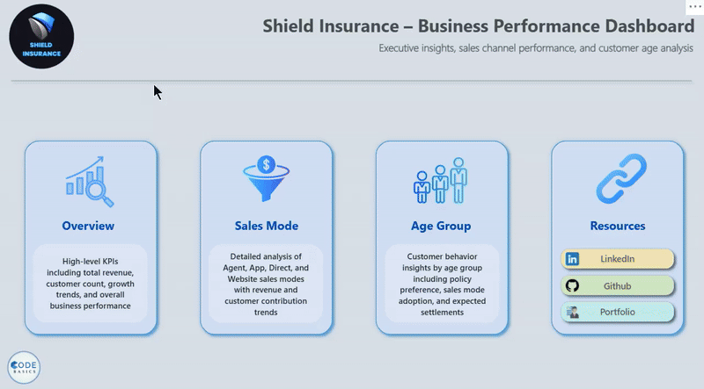
How Navigation Works

